Slide 1
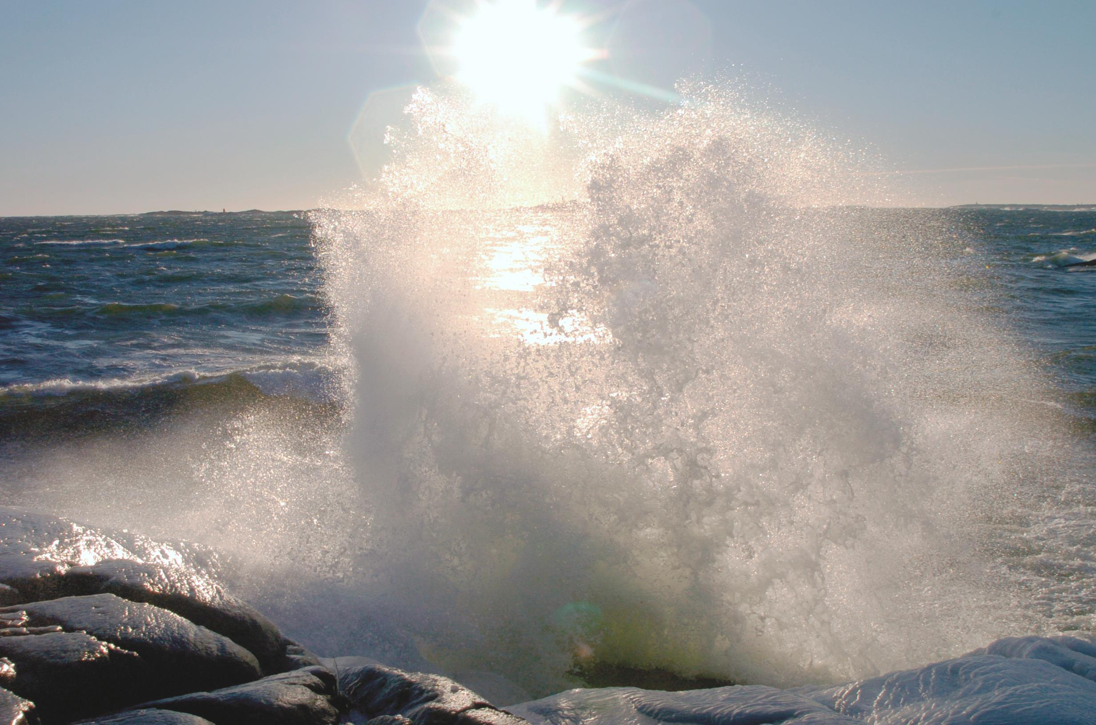


BONUS
The joint Baltic Sea
research and development programme
Role of projects in
support of transnational policy
Maija Sirola, maija.sirola@bonuseeig.fi
CBSS Baltic Sea Science Day, 8 February 2017, St. Petersburg

Slide 2
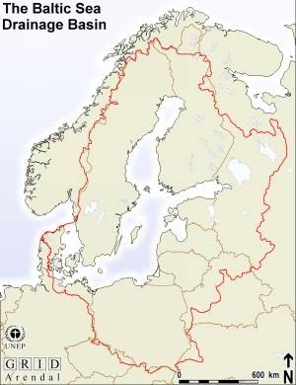
Participating states
Eight EU member states surrounding the Baltic Sea
Russia participates through bilateral agreements
All members channelling their Baltic Sea research funding through BONUS

Slide 3

  A bottom-up initiative of national funding agencies, matching funds from EU FP7, total of EUR100 million
Fostered by several parallel EU policy processes of 2000s:
  DG RTD: European Research Area
  DG MARE: Maritime and Common fisheries policies
  DG REGIO: EU Strategy for the Baltic Sea Region
  DG ENVI: MSFD and HELCOM BSAP
Covers fields with direct impact on Baltic Sea ecosystem and sustainable use of goods and services

Slide 4
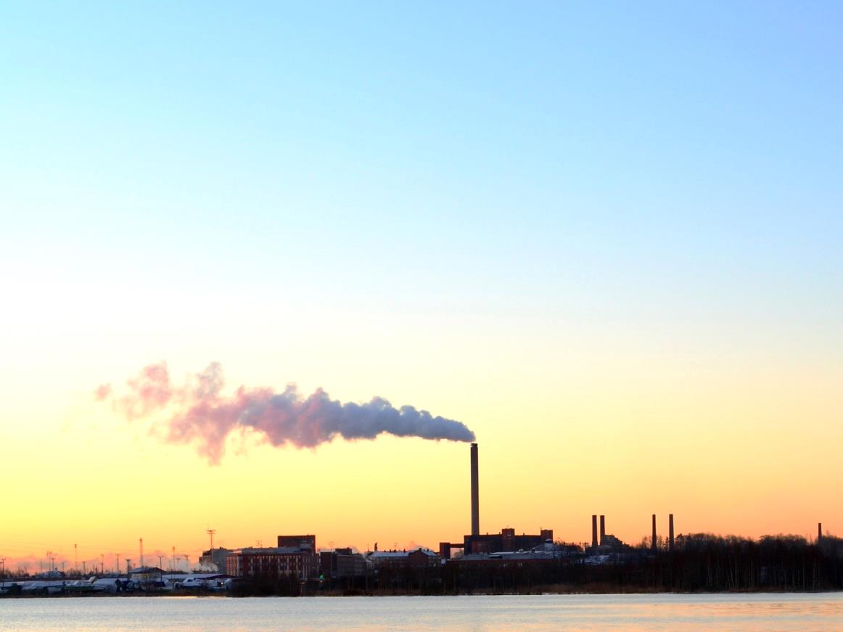
A trend-setter and testlab in EU macro-regional issues
first and only programming and funding initiative integrating marine and maritime research
coordinating and delivering cutting edge science
underpinning national and EU policies, contributing to sustainable blue growth and related EU strategies
Marine ecosystem management needs to be based on best knowledge and innovation – science ja technical solutions need to support protection action

Slide 5

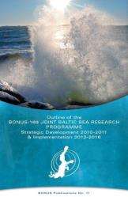
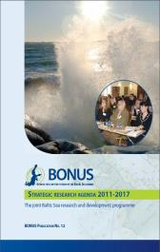
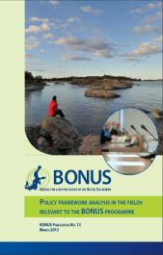
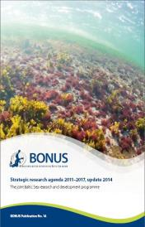


BONUS strategic research agenda
FOCUs on Ecosystem
LAND-coast-SEA CONTINUUM
innovation
Policy landscape MAPPING
blue growth in
northern regional seas
BS and NS Strategic research & innovation agenda
?
2006
2010
2011
2013
2014
PROCESS
a systemic approach responding to
dynamic development in relevant policy fields
2016
2017

Slide 6

19 themes
Coast and catchment
Societal responses
Ecosystem
Sustainable use of
goods and services
Observation and
data management

Slide 7
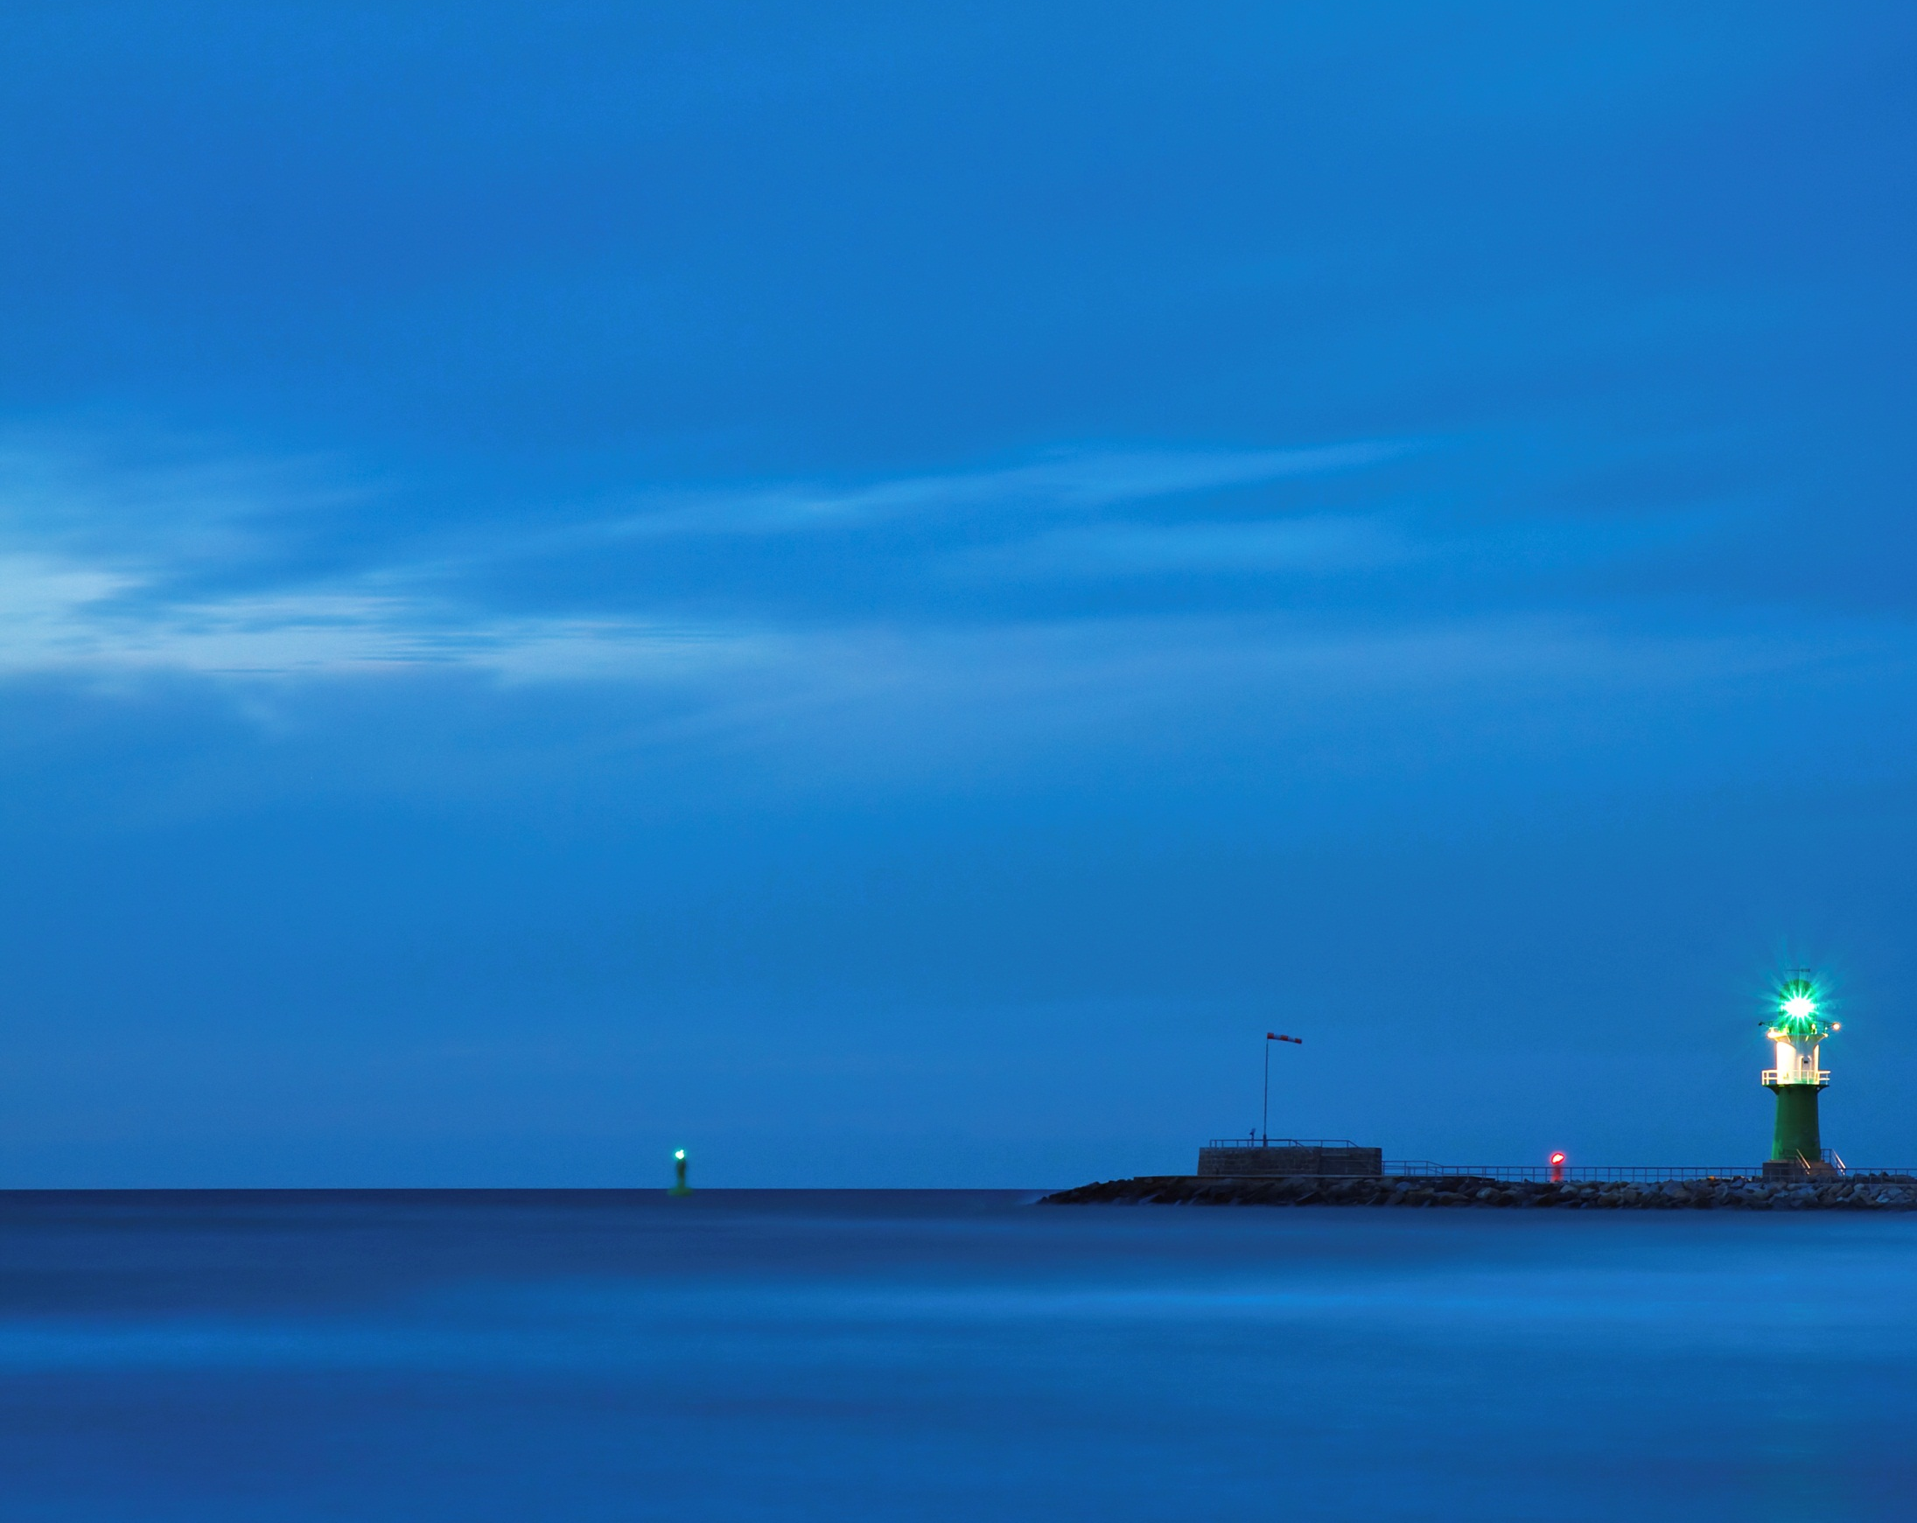
BONUS calls:
4 calls in BONUS Art 185 and 1 in BONUS+
56 projects worth over EUR 100 million involving a total of 16 countries
Over 130 region’s leading universities and institutions and 30 businesses
Over 800 researchers (from Art 185 excl. Blue Baltic)
Announcement on 1 April 2017: 12 Blue Baltic projects to be implemented during 2017-2020
Also in 2017: Call to fill in remaining SRA gaps

Slide 8
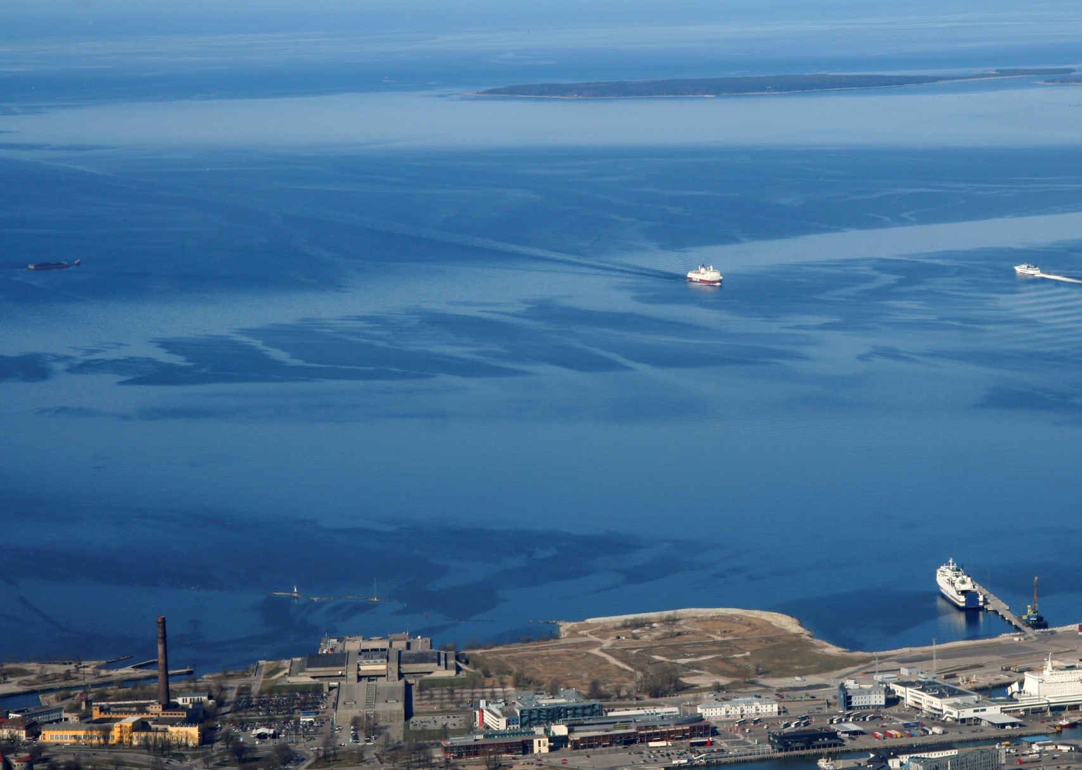
BONUS Art 185 projects...
develop ways to reduce loadings from the catchment
boost sustainable fisheries
look for environmentally safer maritime activities
develop methods and approaches to trade-offs between various sectors and interests
develop new methods for monitoring, surveillance and assessment
create new knowledge about marine ecosystems

Slide 9
BONUS projects in science policy interface in 2016:
313 BONUS researchers as members in the stakeholder committees (HELCOM, ICES, EU etc)
58 significant contributions to ’fit-to-purpose’ regulations, policies and management practices
43 suggestions for designing, implementing and evaluating the efficacy of relevant public policies and governance originating from the work of the project

Slide 10
BONUS projects in science policy interface in 2016:
BONUS INSPIRE 100+ contributions in stakeholder committees to fisheries management -> Critical revision of the existing management for cod, herring and sprat in the Baltic based on spatial ecology data of fish stocks
Underlined contributions by BONUS BAMBI, BALTSPACE, BALTCOAST to the Baltic Sea MSP work
Russian partners of BONUS COCOA participate in the second assessment report on climate change in Russia
                etc…

Slide 11
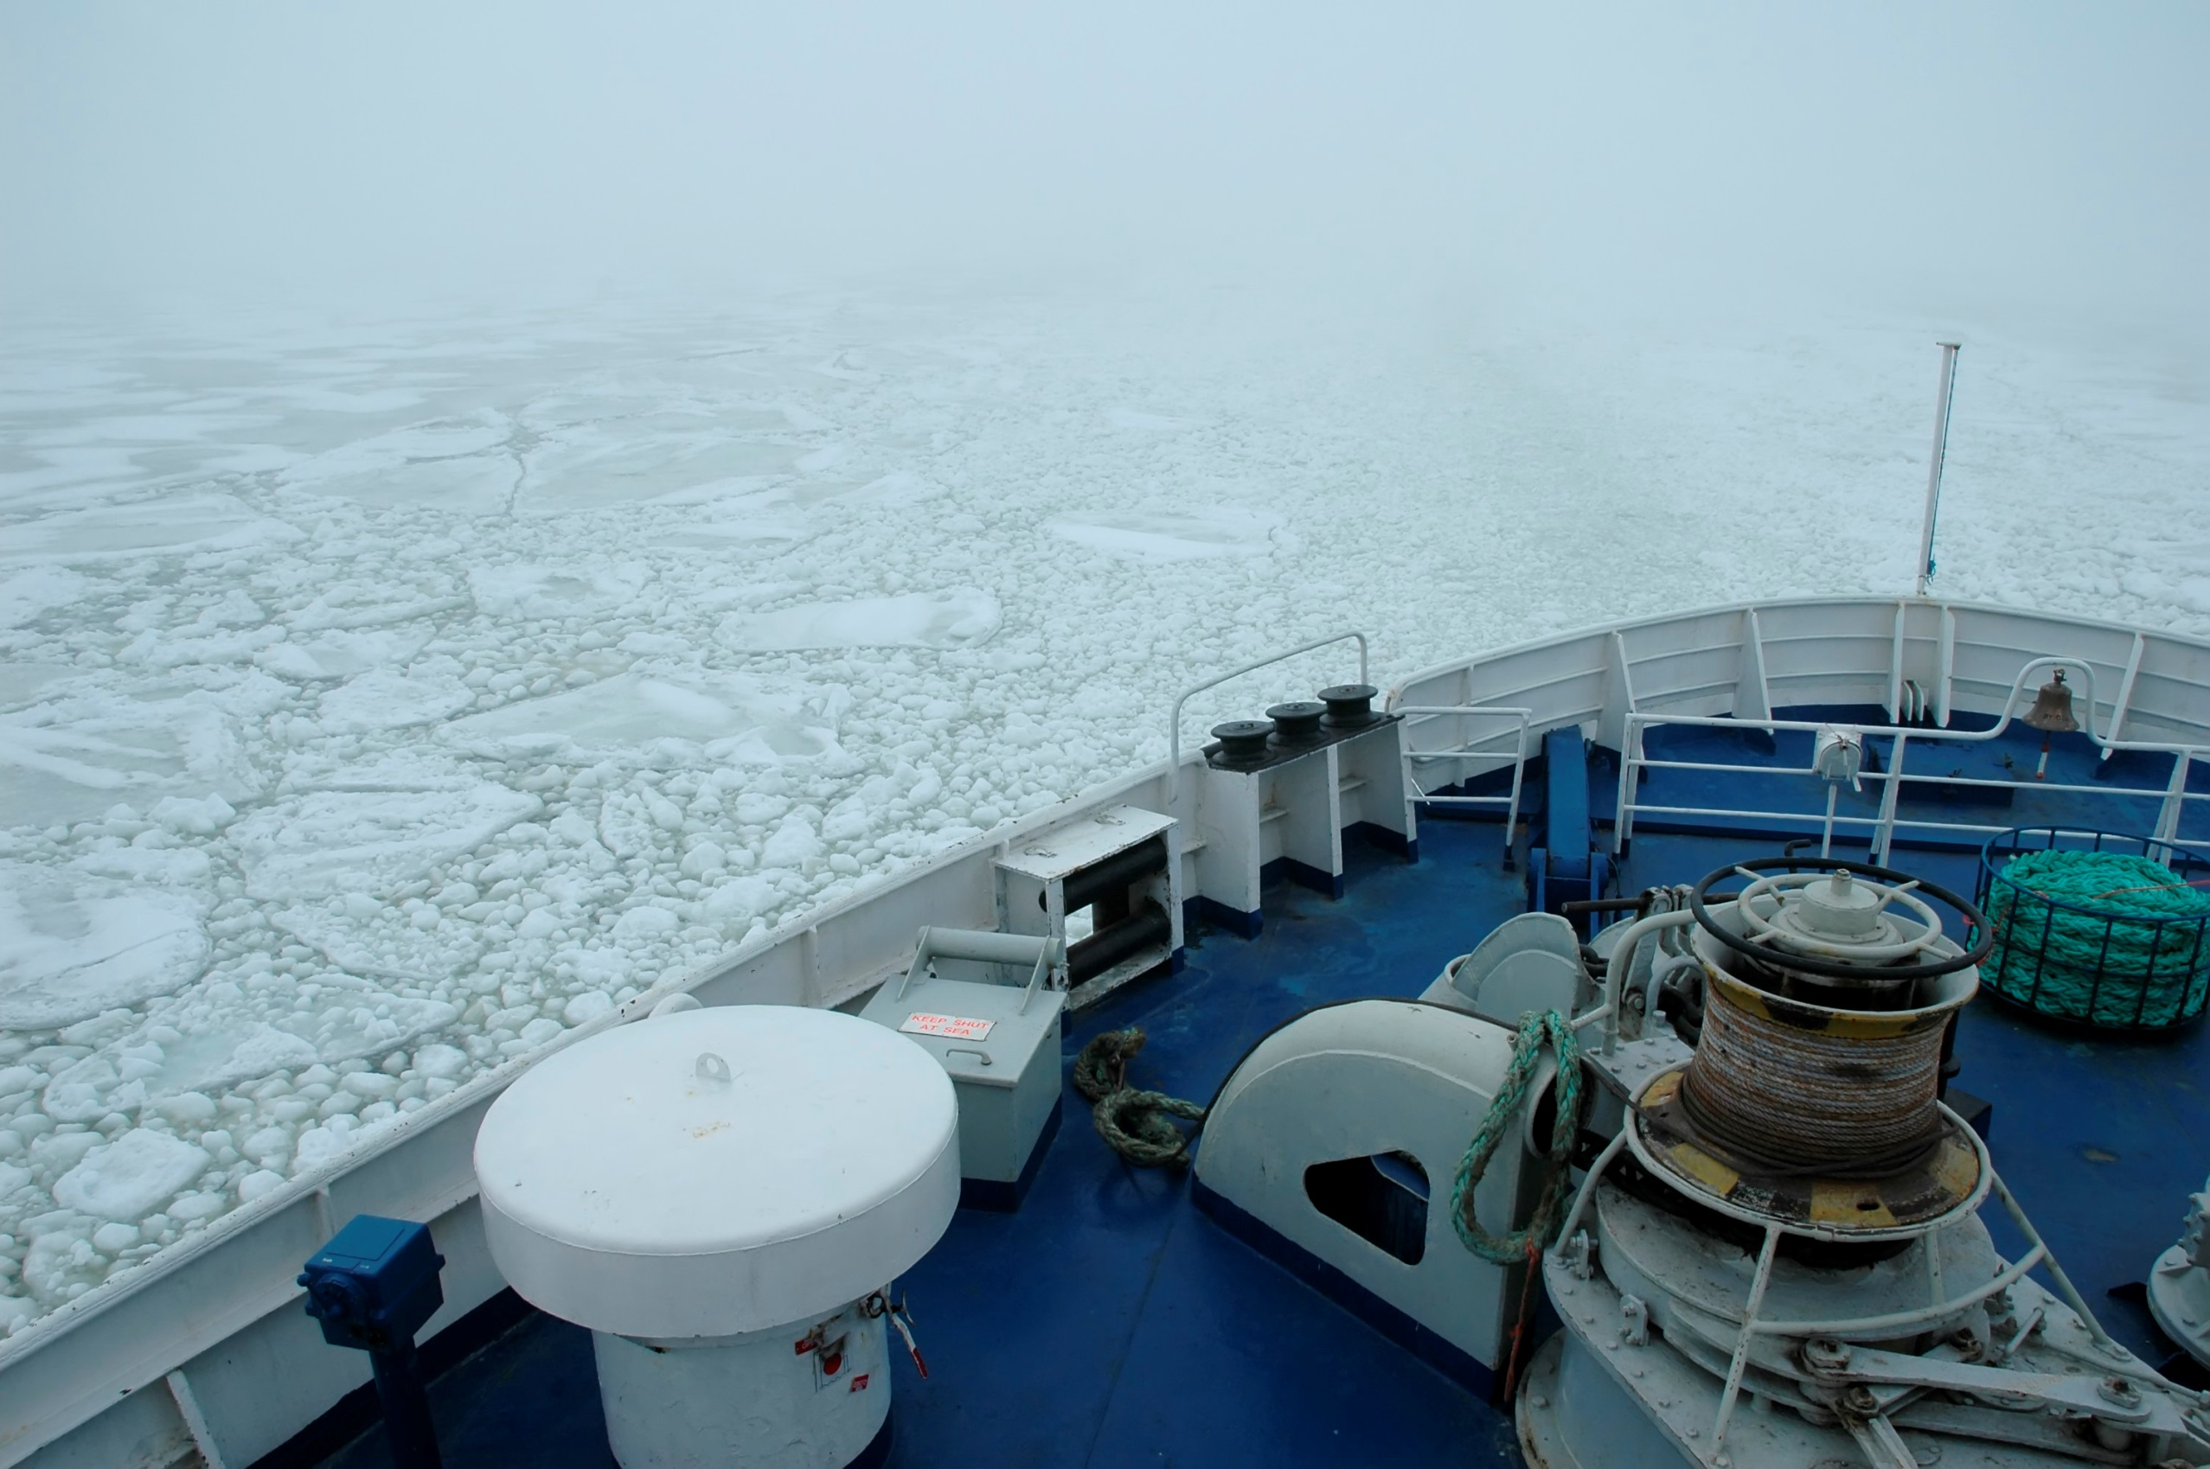
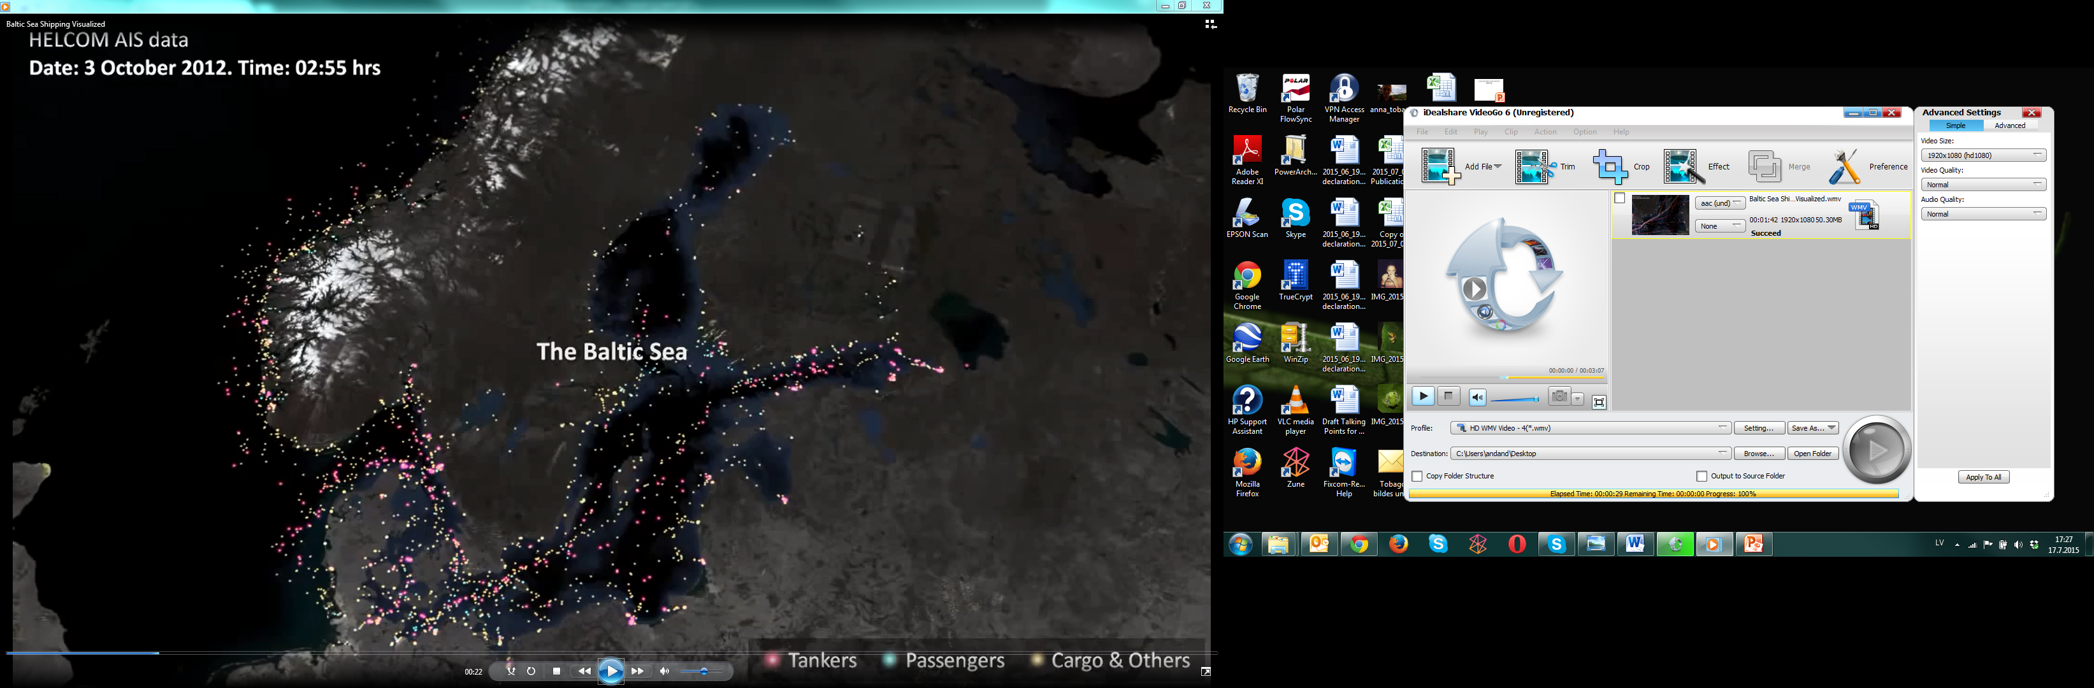
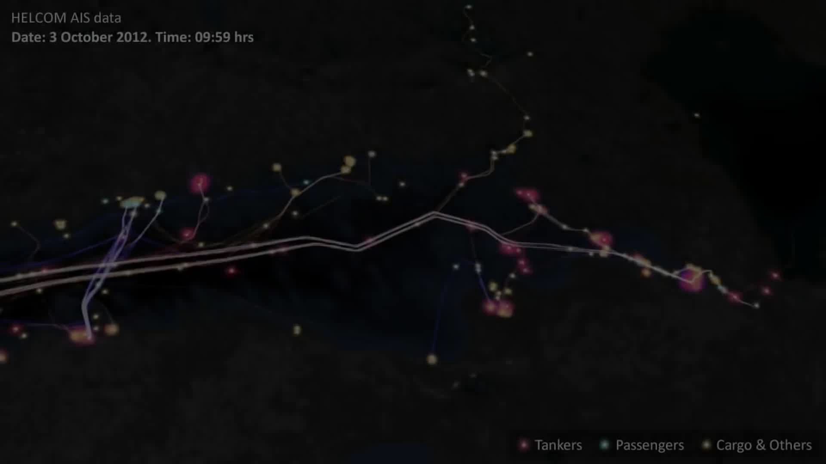
STORMWINDS
ZEB
.
GEOIL
WATCH
ESABALT
2000 ships at any moment
SHEBA
ANCHOR
HARDCORE
SWERA
Source: http://helcom.fi/action-areas/shipping/ais-and-e-navigation/ais-video
30 sek

Slide 12
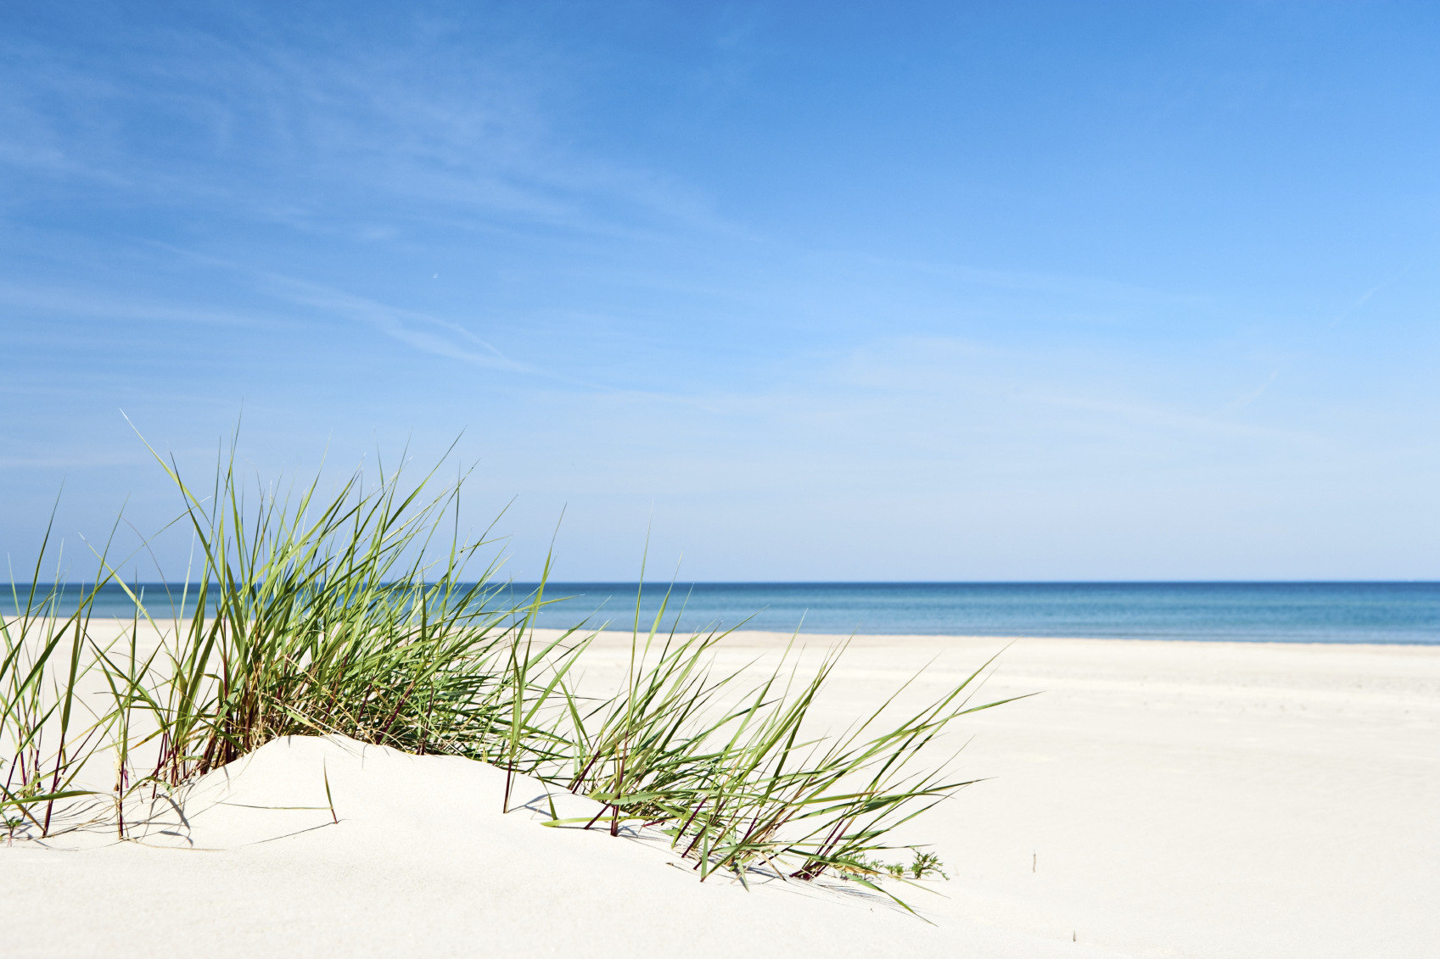
Collaboration with other initiatives and networks through broad communications programme, joint stakeholder platforms, contributions to strategic planning (SOWs), advisory board, joint young scientists training activities etc. On macro-regional level:
HELCOM
VASAB
Interreg Baltic Sea Region Programme
EUSBSR
CBSS and Baltic Science Network - “The EU-BONUS-programme is a best practical model for successful joint research programming in the BSR”

Slide 13
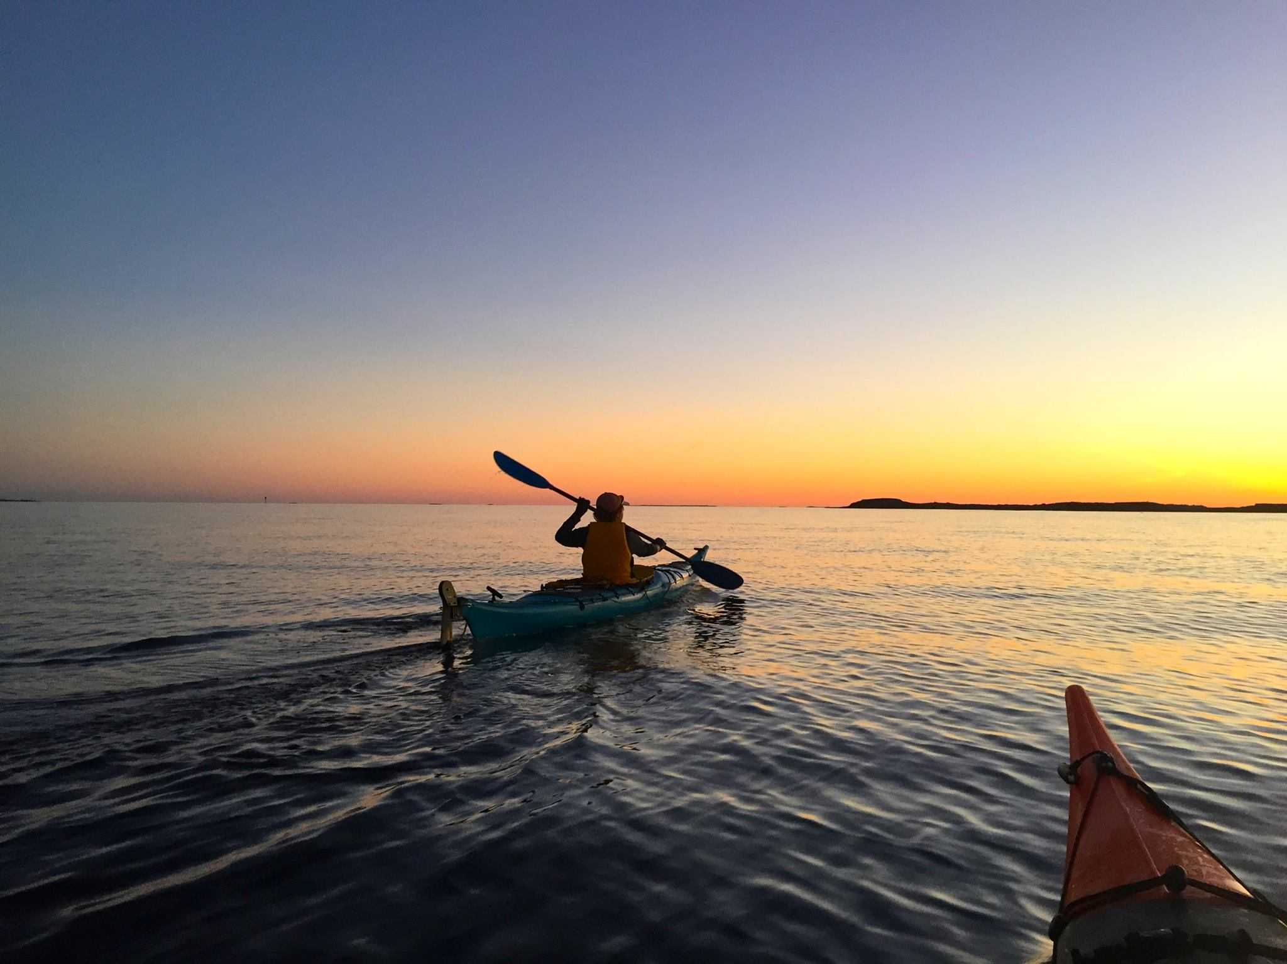
THANK YOU!
Maija Sirola
maija.sirola@bonuseeig.fi
www.bonusportal.org
www.bonusportal.org/projects

